Slide 1

-A deep dive into NREL’s Solar Radiation API and utilizing machine learning to forecast the potential usage of solar energy.
Forecasting Solar Radiation and it’s Potential
Trent Little

Slide 2
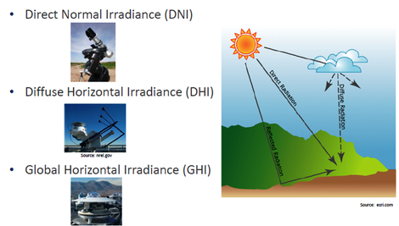
Overview of Subject Material
Solar Radiation consists of 3 variants:
NREL: National Renewable Energy Laboratory
SAM: System Advisor Model
FBProphet: Machine Learning Module
Modeled on 2000sq/ft, 2 story house in Arlington with a family of 4.

Slide 3
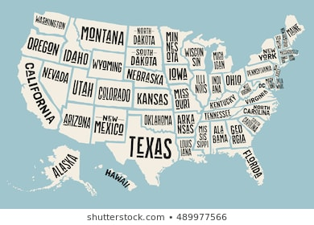
Overview of Subject Material

Slide 4

Overview of Subject Material

Slide 5
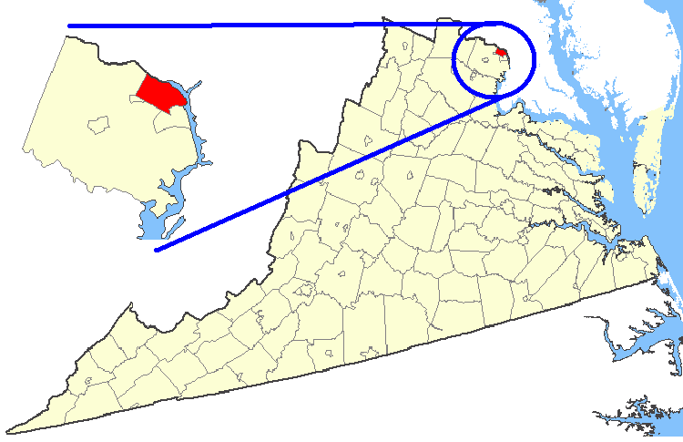
Overview of Subject Material

Slide 6
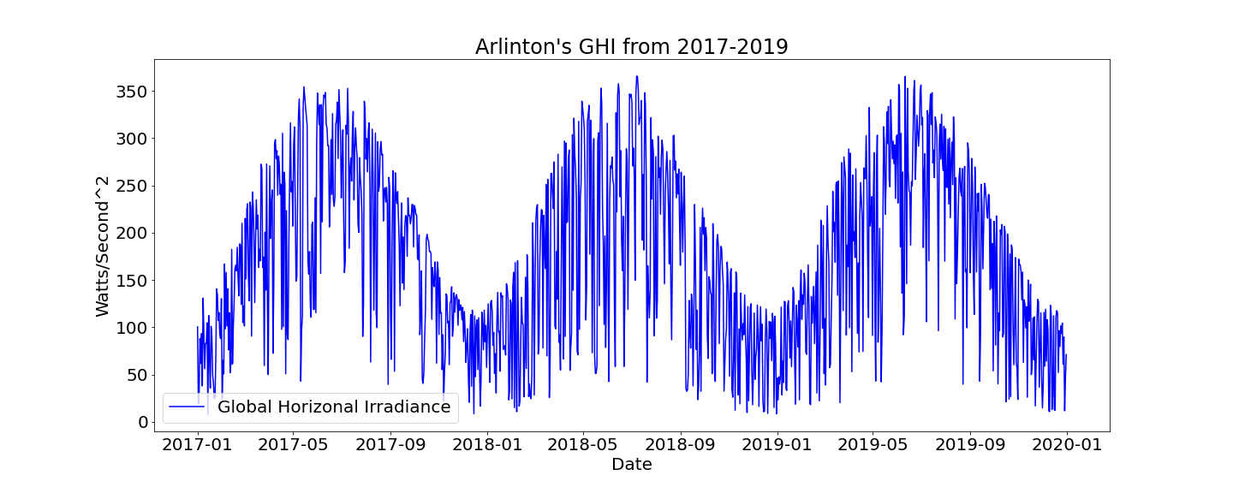
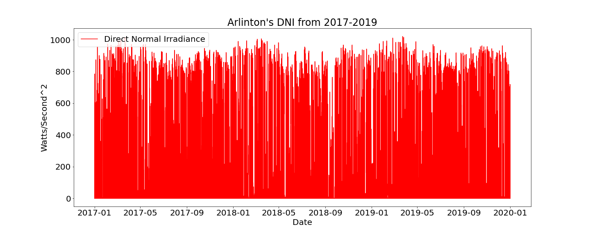
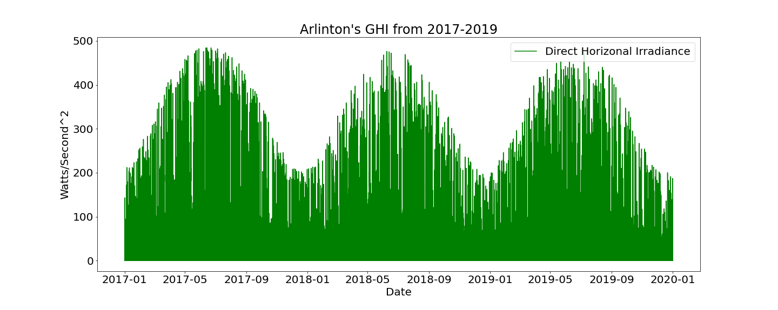

Slide 7
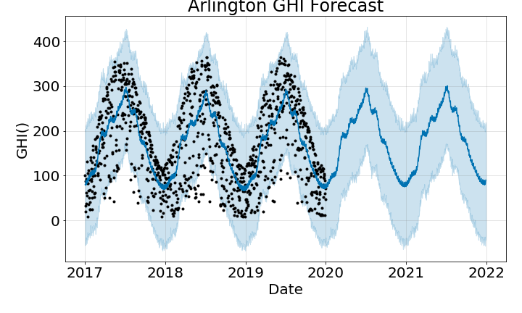
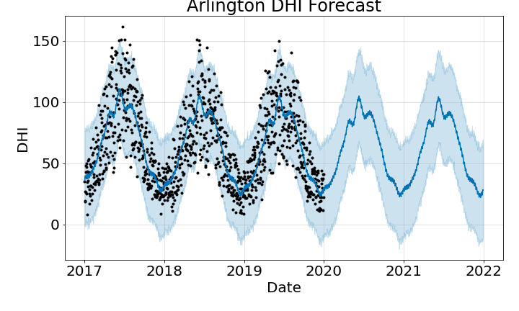
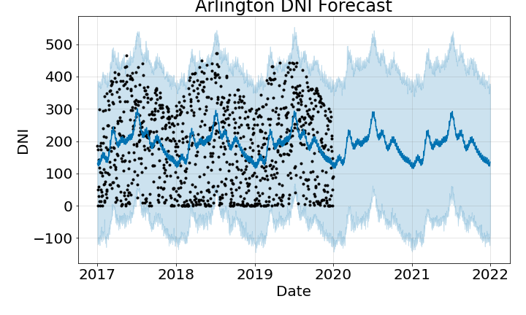

Slide 8
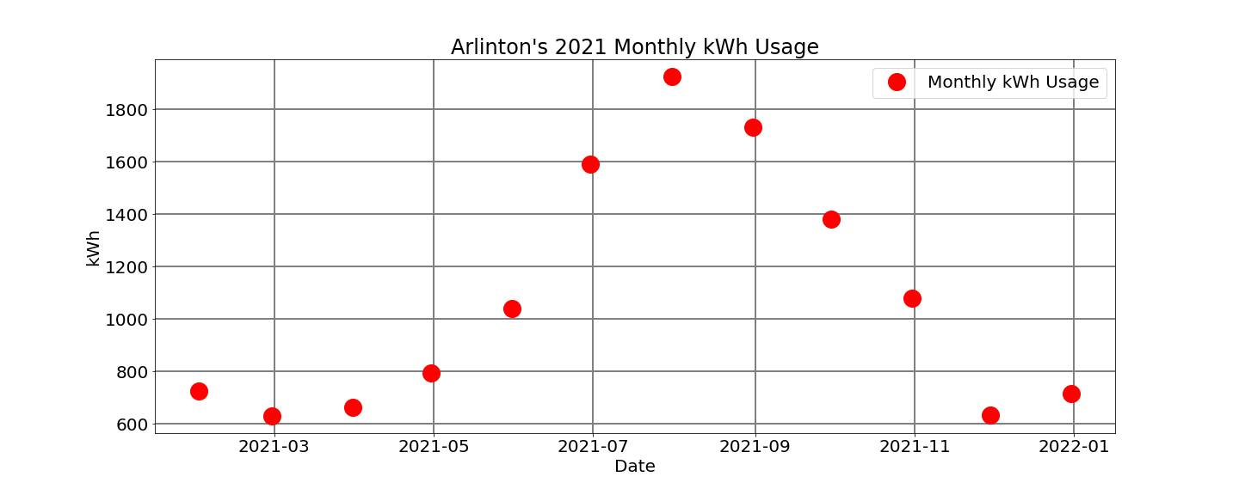
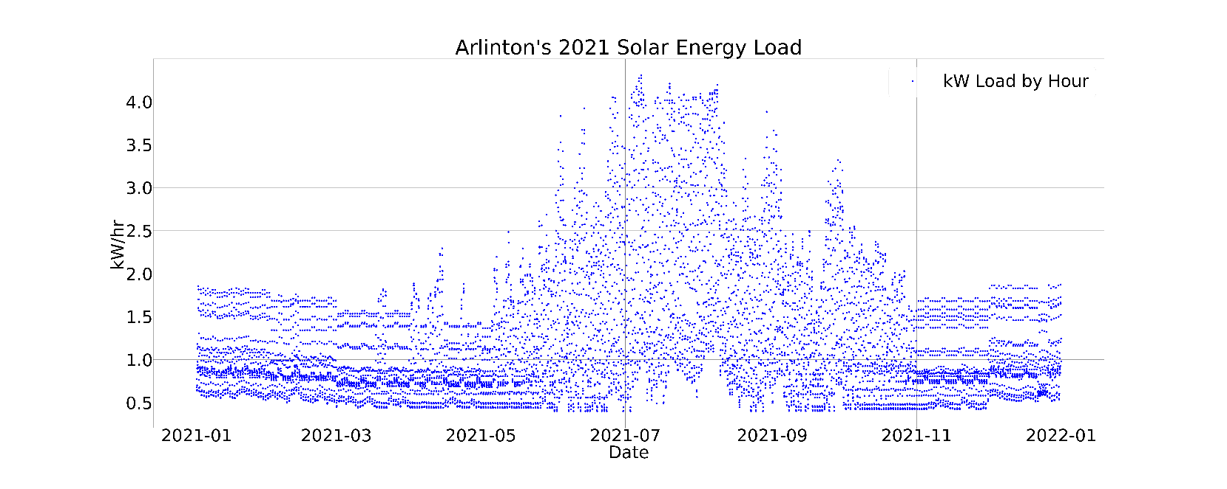
Analyzing Forecasted Data

Slide 9
Implications?
Costs and Benefits of Solar Panels
Cost of Electric Consumption
$15,000
Produces 500-700 W/hr
Avg of 1.4 kW/hr from Solar Irradiation in Arlington Area.
Residents avg 1117 kWh/mo
11.08 cents per kWh
Avg of $124/mo
Saving of about $70-90 per Month
(Before including Upfront Cost)

Slide 10
Questions?
Trent Little

